Slide 1

Top 10000 Popular Movies Analysis
By: Rahul Kumania

Slide 2
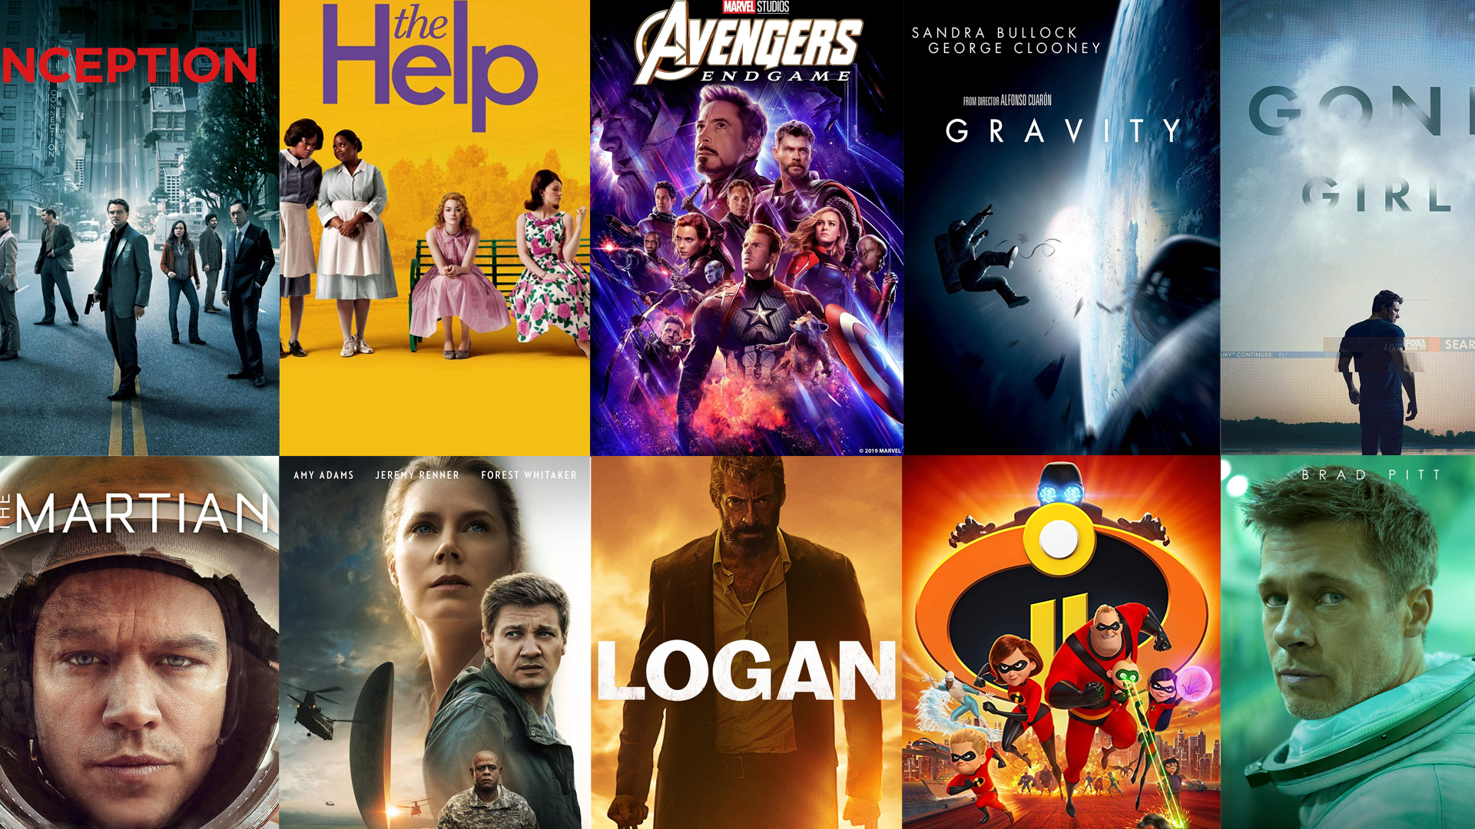
About Dataset: -
The Dataset was acquired from Kaggle website where it was created from the Movie Database (TMDB) which is a popular, user editable database for movies and TV shows.
This is the dataset for 10000 Popular movies based on their TMDB ratings.

Slide 3
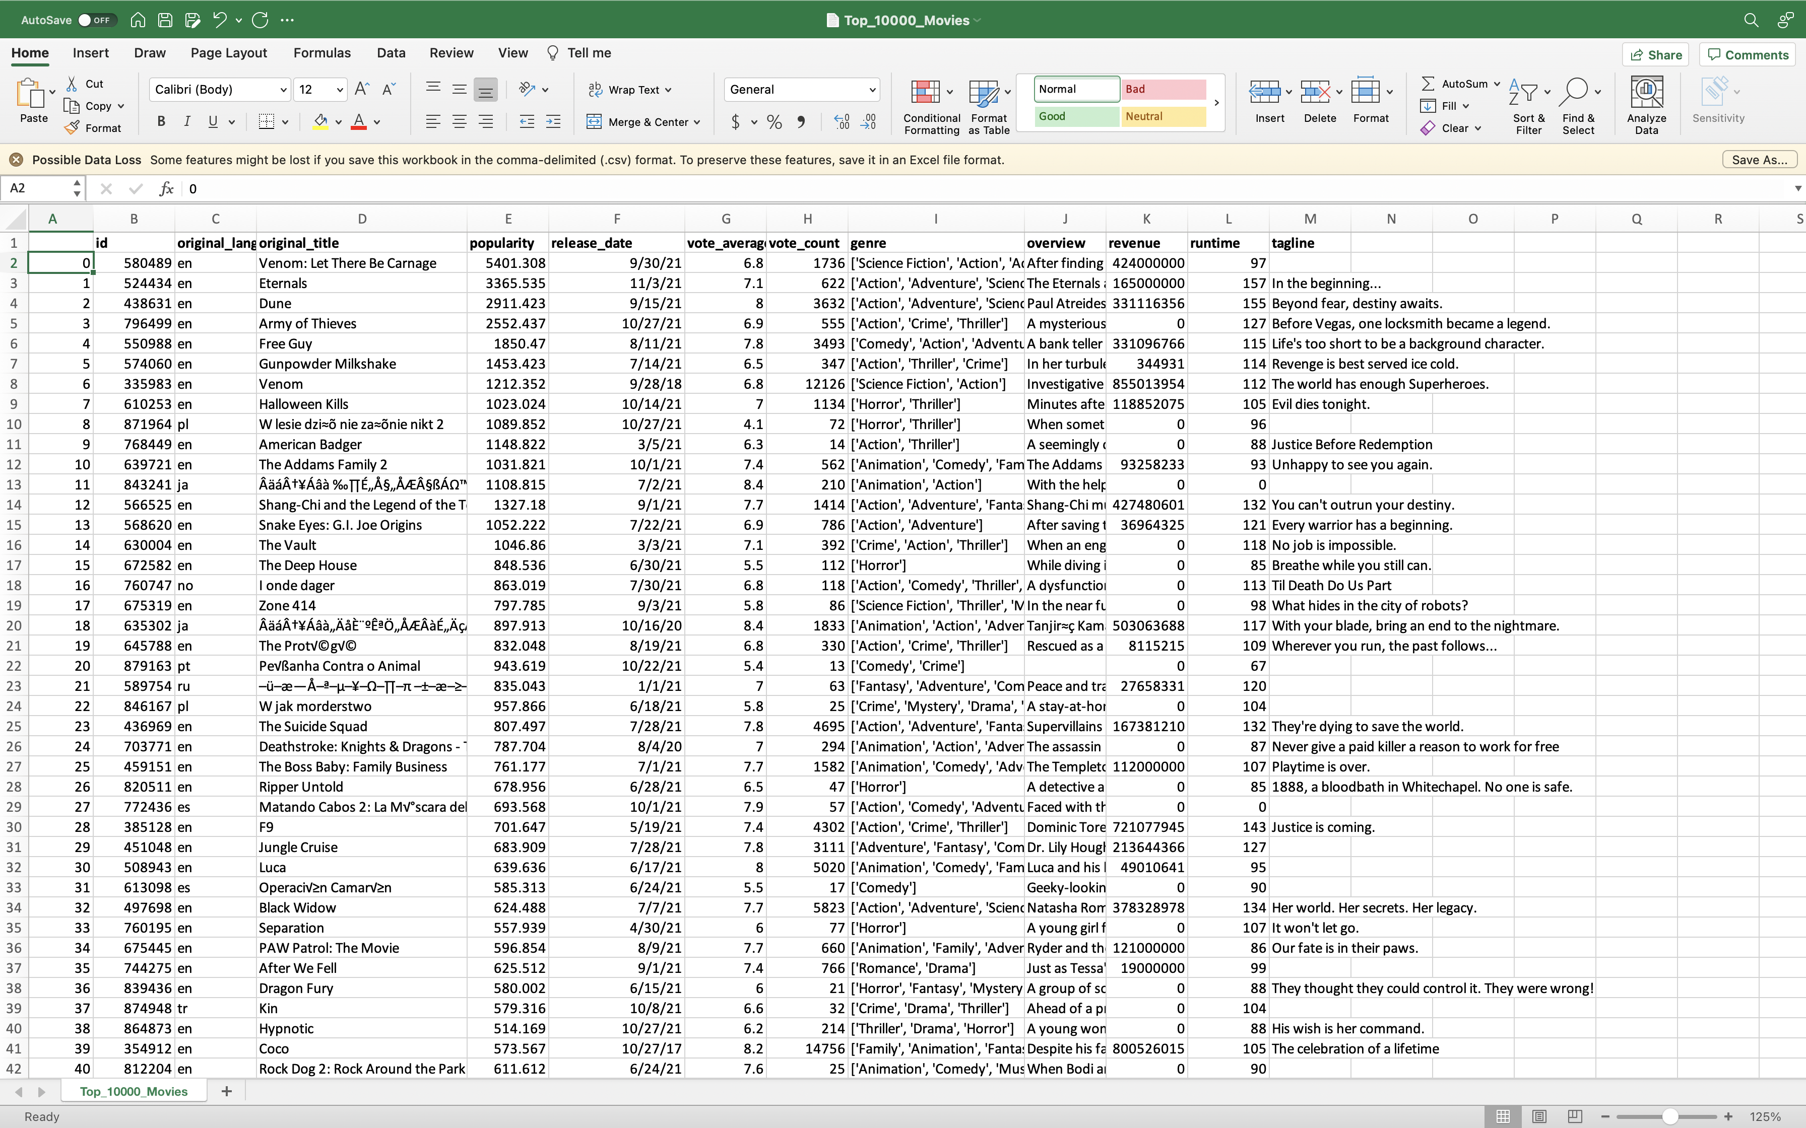
Screenshot of Dataset

Slide 4
Attributes of Datasets: -
id - Every movie has its unique ID.
original_language - There are total 44 languages present in this column. Total 7771 movies with 'English' as original language. Values in this column are ISO 639-1 codes of languages. I.e 'en' for 'English' , 'hi' for 'Hindi' etc.
original_title - Title of the movie.
popularity - Popularity of movie. Bigger the number , higher the popularity.
release_date - Release date of the movie. If release date is not present for any movie , then that movie is not released yet.
vote_average - Average of rating/vote for the movie.
vote_count - Number of ratings/vote recorded for the movie.
genre - Genre of the movie.
overview - Brief description of movie in string format.
revenue - Revenue of Movie
runtime - Runtime of movie in minutes.
tagline - Tagline of the movie

Slide 5

What my program will do: -
I will be doing an exploratory data analysis on this dataset. In which my first step is going to be cleaning of datasets and look for any missing and duplicates values. Later, I will be moving to the visualization of the dataset in respect to answering my questions.
My program will answer some important questions: -
Most used languages in popular movies?
Average runtime of popular movies?
Plotting the relationship between runtime and votes of a movie.
Plotting the relationship between Revenue vs Runtime.
Genres of Top-Rated Movies?
Plotting the relation ship runtime and popularity of movies.

Slide 6
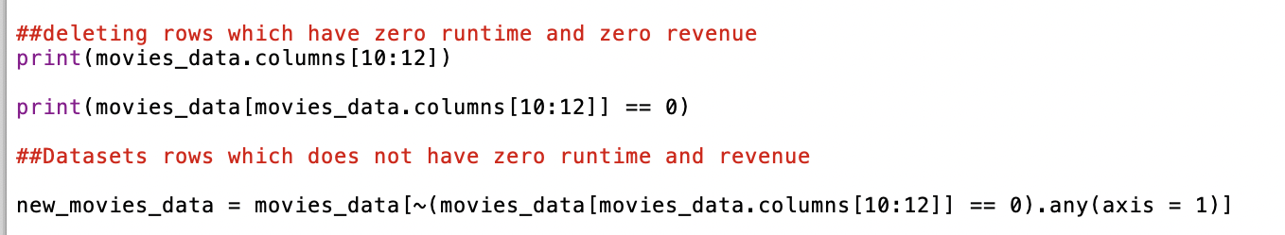
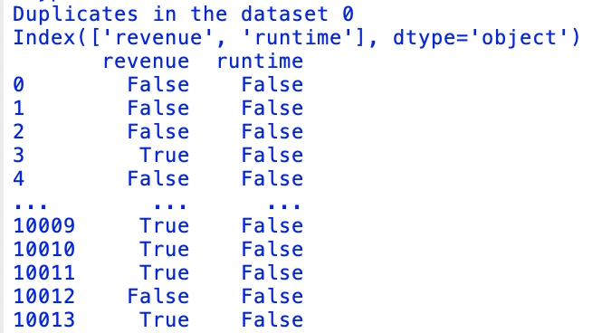
Cleaning of datasets and look for any missing, duplicates, and null values: -

Slide 7
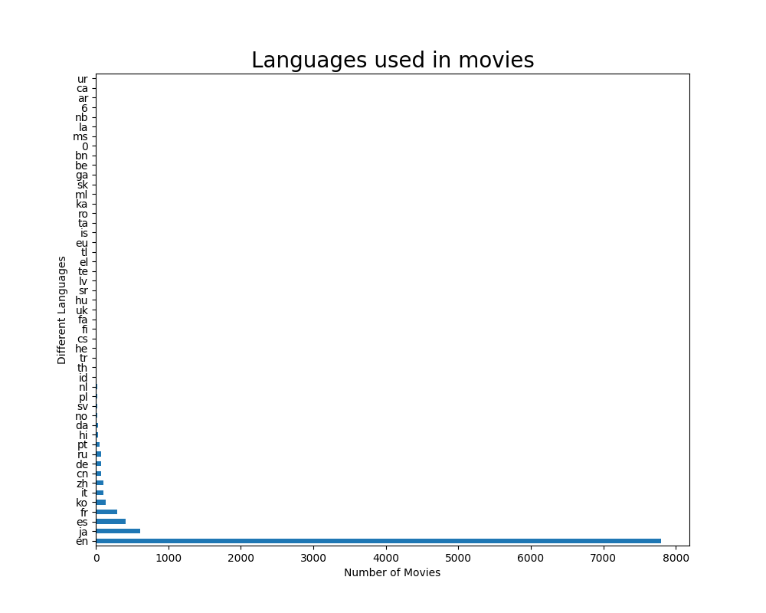
Most used languages in popular movies?
All the languages used in top 10,000 movies: -
This Bar graph shows the big picture of all languages used in top 10,000 movies.
To narrow it down we I was able to see that there are some languages which are just been used once or twice.

Slide 8
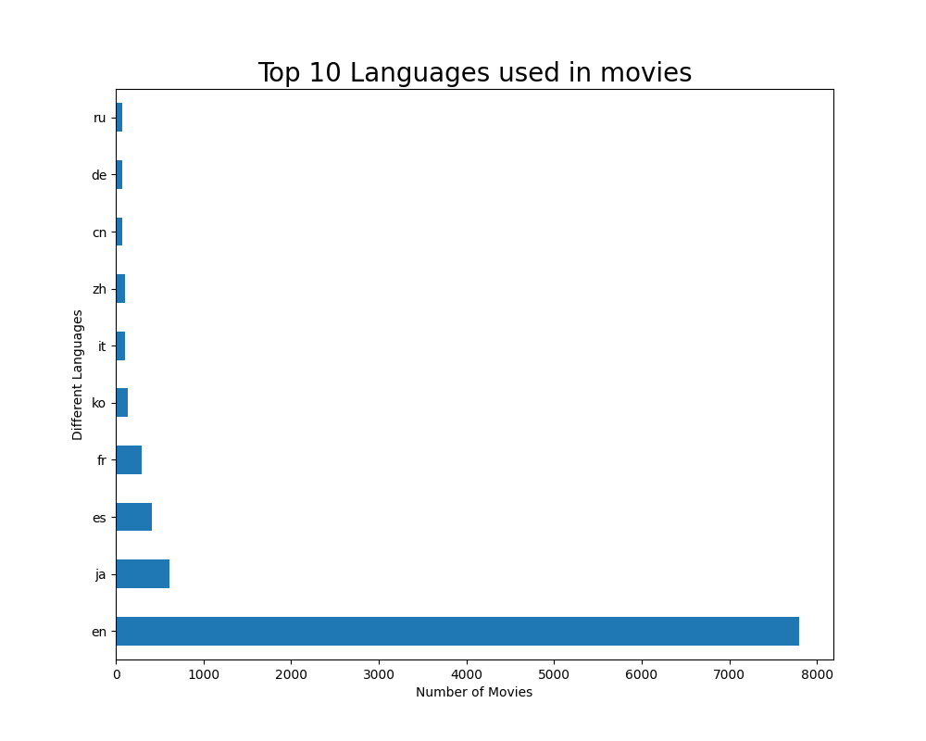
Most used languages in popular movies?
Top 10 languages used in top 10,000 movies: -
Keeping that previous though in my mind I generated a bar graph which specifically talks about top ten languages used in popular 10,000 movies by using head() function.
Benefit of this Graph:
This provides an idea to movie creators that they should opt for English, Japanese, Spanish, and French languages since they are top languages when it comes to popularity.

Slide 9
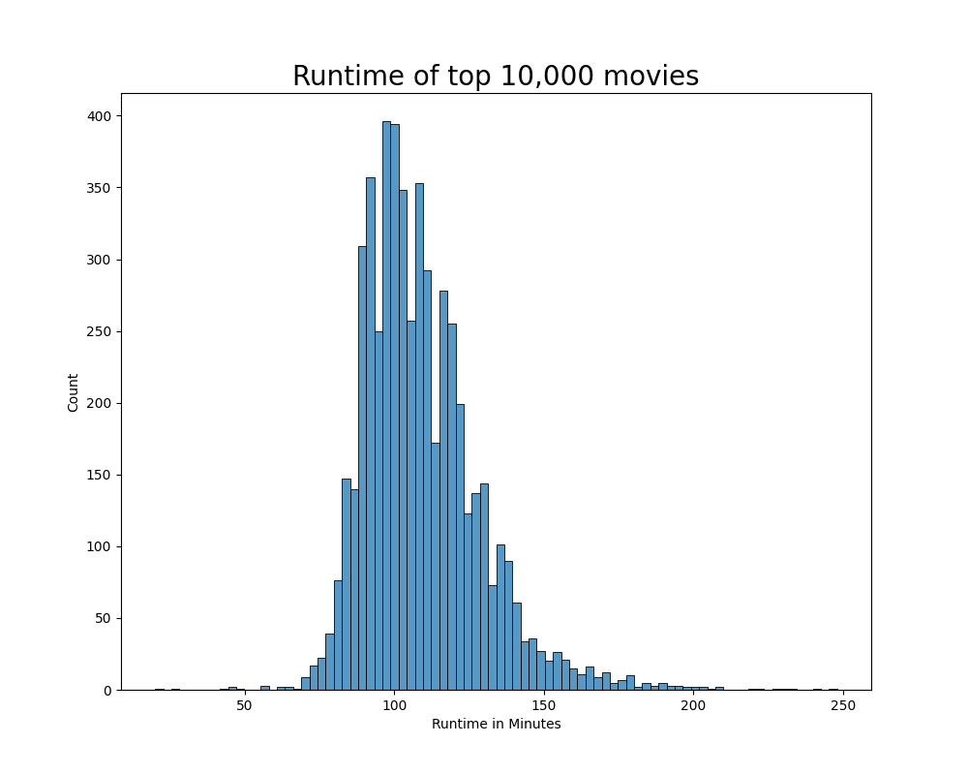
Runtime of popular movies?
This bar graph was created by the help of seaborn which shows the runtime of the popular 10,000 movies.
We can clearly see that average runtime of popular movie lands between 100 and 150 minutes.

Slide 10
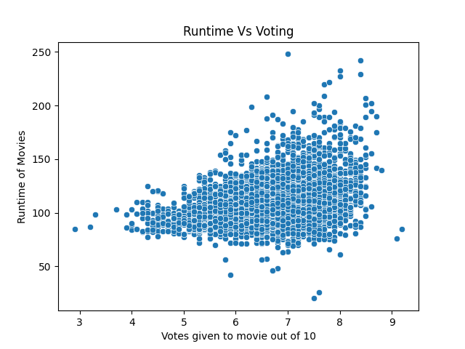
Relationship between movies runtime and its voting: -
This is a scatter plot between runtime of movies and ratings given to it out of 10.
This scatter plot reveals an interesting insights about the ratings of the movies which are:
Movies with runtime of 100 to 150 minutes got a lot of 7 -8/10 ratings.
Movies with runtime of 150 to 200 minutes got a lot 7.5-8/10 ratings.
Benefit of this graph:
This gives an idea to film creators that they should keep their movie runtime from 150 to 200 minutes if they want to achieve some good ratings among their audience and critics.

Slide 11
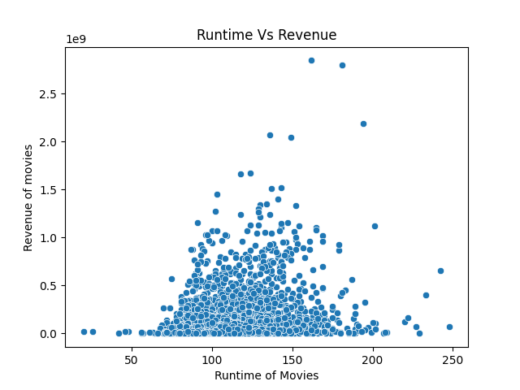
Relationship between movies runtime and revenue: -
This is a scatter plot between runtime of movies and their revenues.
This scatter plot reveals an interesting insights about the revenue of the movies which are:
Movies with runtime of 100 to 150 minutes makes good amount of revenue among viewers.
Movies with runtime of 150 to 200 minutes shows better number of revenues among viewers.
Benefit of this graph:
This gives an idea to film producers that they should keep their movie runtime from 100 to 200 minutes if they want to achieve some good revenue among their audience.

Slide 12
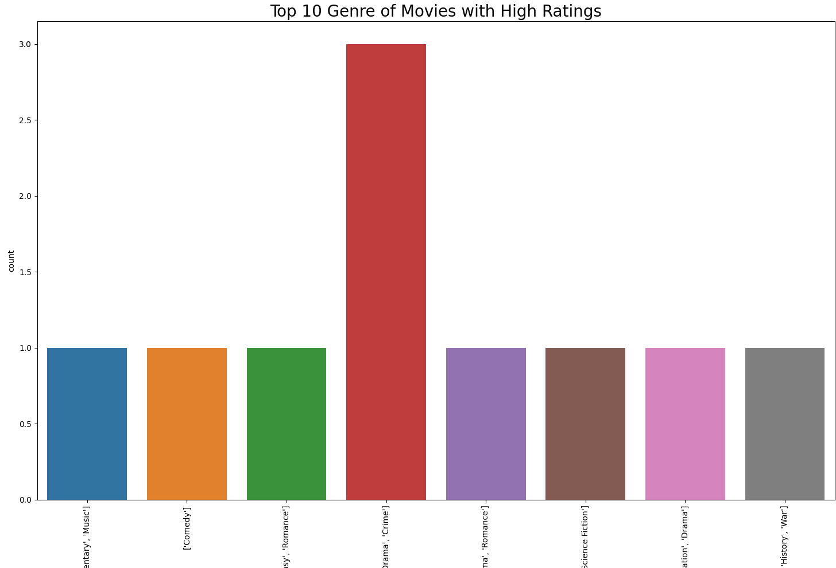
Genres of Top-Rated Movies?
This
This bar graph shows movie genre with high ratings.
As we know this dataset contains 10,000 rows of movies, I used head function to get the top 10 genres with high voting_average (ratings)
top_movies = new_movies_data[new_movies_data["genre"] != "[]"].sort_values(by="vote_average", ascending=False).head(10)

Slide 13
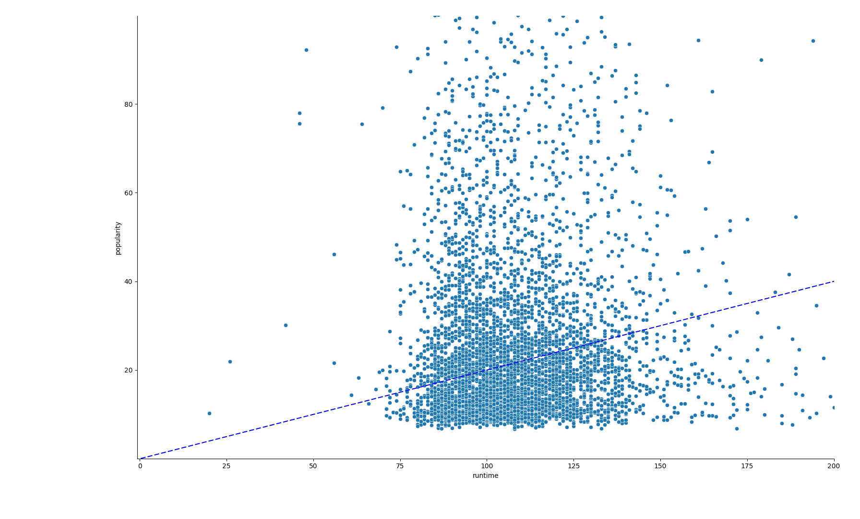
Relationship between movies runtime and their popularity: -
This is a scatter plot between runtime of movies and their popularities.
This scatter plot reveals an interesting insights about the Movies runtime:
Runtime of 100 to 125 minutes have a really high popularity among audience.
Runtime of 75 to below 100 minutes have low popularity.
Benefit of this graph:
This gives an idea to film producers and creator that they should keep their movie runtime from 100 to 150 minutes if they want to achieve heavy popularity.

Slide 14

Benefit of my EDA program: -
We know recommendation systems are used everywhere now a days and datasets like this are great way to reveal insights that can help audience. Keeping this in mind with the help of my EDA program audience can pick what genre they should watch in respect to which movies fall under top 10000 movies.
Identifying patterns by visualizing data in graphs such as scatter plots and histograms in respect to movie genres, revenue and runtime it will help producers, directors and actors to pick specific movies in which they can make big amount of profit and can grab more popularity.
Also, program can help reveal insights for online platforms like Netflix, amazon, hulu, HBO and etc about which popular movies should they stream on their platforms, which can attract more customers.

